Slide 1
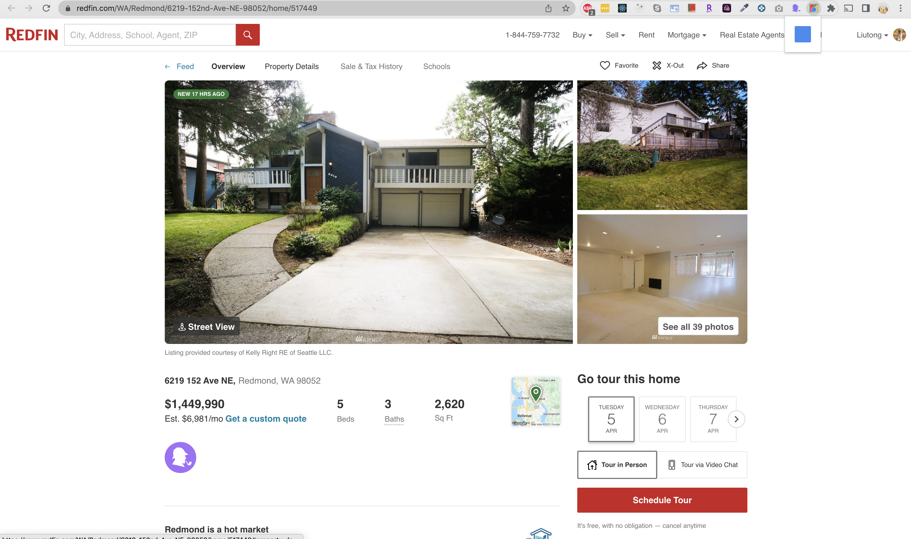









Crime
Noise 78
Demographic
Average Income 150,000
Housecreep None
Rent Price 2,000/month

